Slide 1
STREAM PROCESSING
GROUP ASSIGNMENT
TEAM A
Mohamed Abdelrasoul Abdelfatah Gomaa Amer
Adelina Akhsanova
Prasanth Chakka
Nisrine Ferahi
Begoña Frigolet
Marang Mutloatse

Slide 2


CHAT

Slide 3
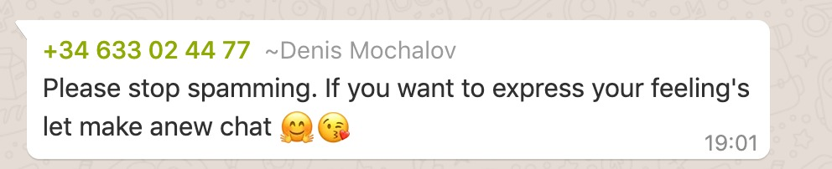
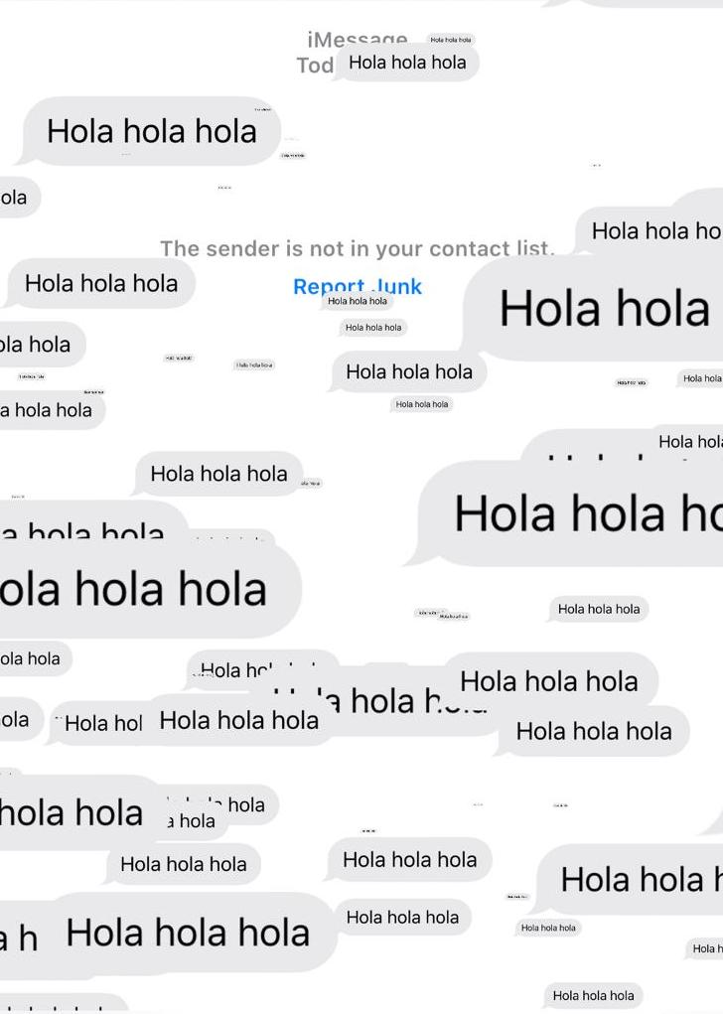
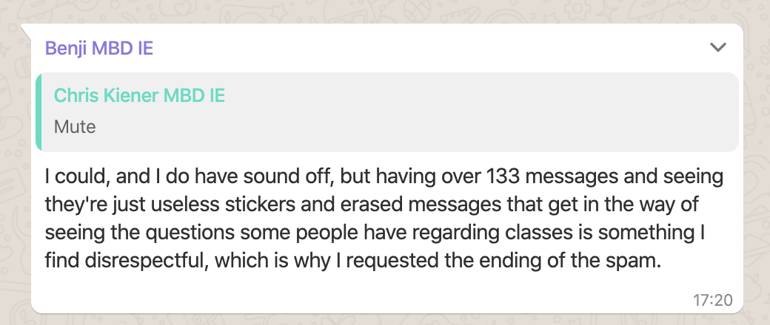
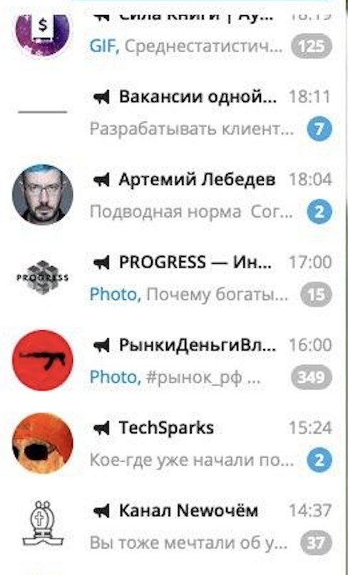
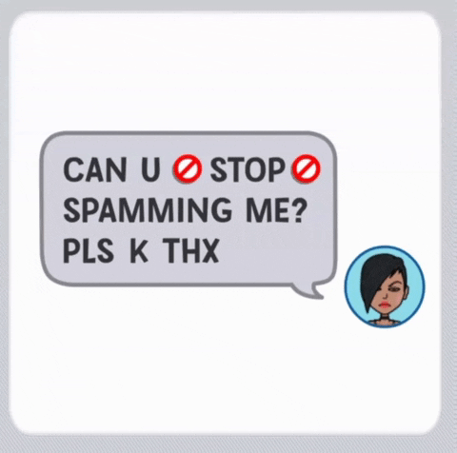
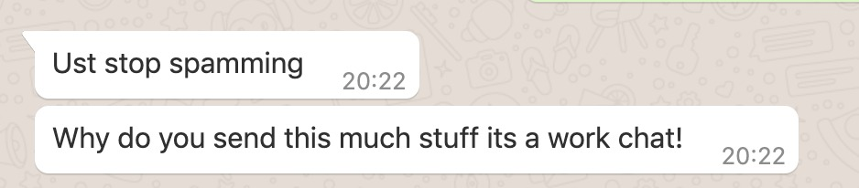
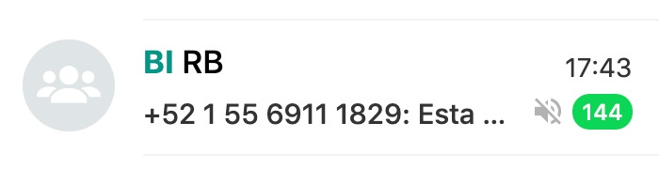
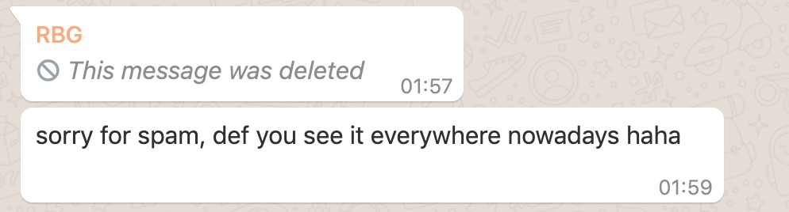
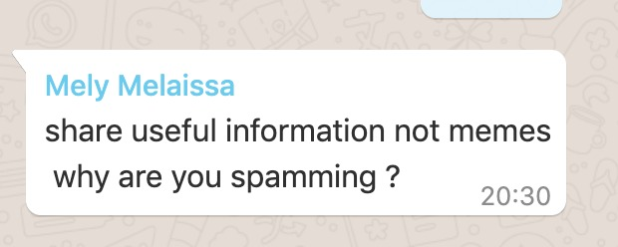

Slide 4
USE CASE
#JOB
1 billion
15 billion
79%
91%
Telegram is targeting 1 billion users by 2022
Telegram messages were being sent daily in February 2016
of candidates use social media as part of their job search
of employers are using social media to help reach candidates.
The Hire, Remote Jobs, JobsAbroad, Finder.VC all of these and more are job communities/channel on telegram where people post links and information about job offers. Now more than ever social media is used for sourcing and recruitment. But what is the point if you are lost in a clutter of 400+ messages?

Slide 5

EXTRACTION PLAN
Spark Streaming
Telegram
Python Server
Mongo DB

Slide 6




TECHNICAL DEEP DIVE
01
Bots in telegram
02
Webhook
03
Python Request Module
03
Spark Streaming
04
Mongo DB

Slide 7
DE
MO

Slide 8
ISSUES / CHALLENGES
01
Connecting to Telegram to fetch messages
02
TCP connection
03
RDD to text
04
MongoDB connection
05
Dashboard

Slide 9
FUTURE WORK
DIFFERENT
USE CASES

Slide 10

THANK YOU

